Slide 1
Creating value
by simplifying work

Slide 2
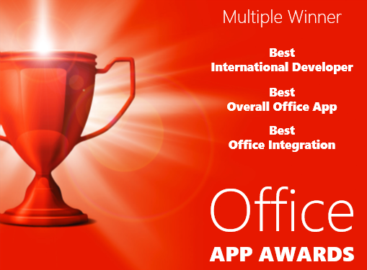
About
officeatwork
Microsoft Partner since 1994

Slide 3
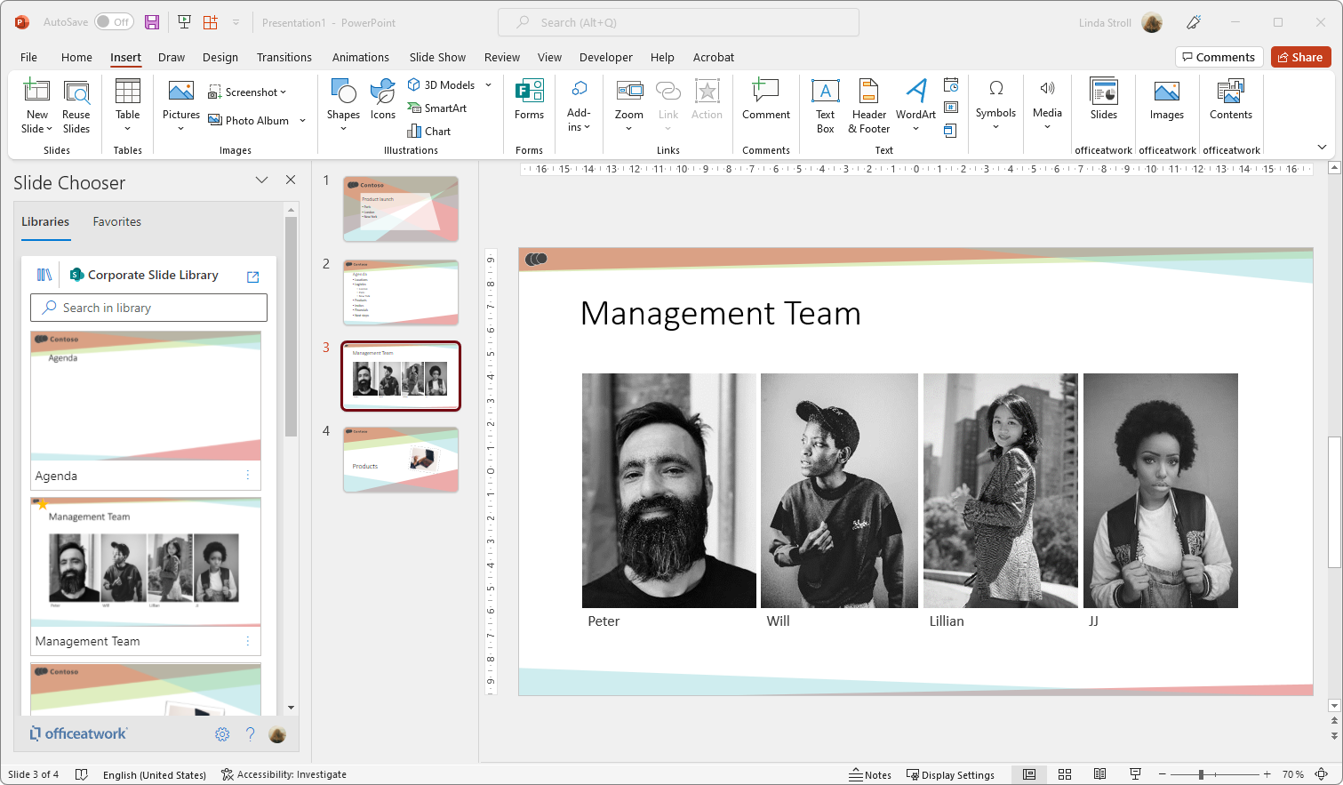
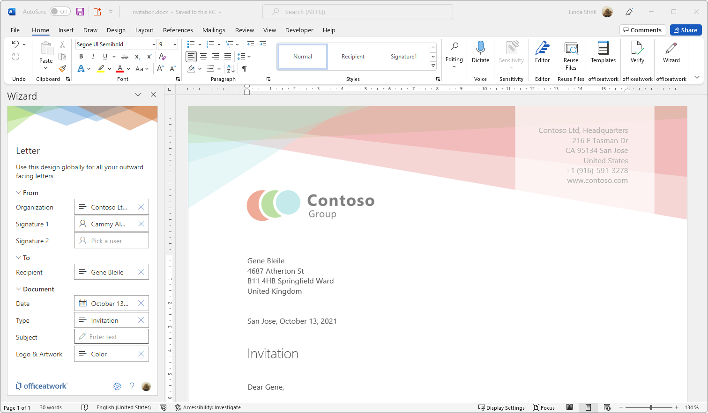
In a nutshell
simplifying work
Your organization’s assets …
Sales
HR
Vision
Images
Logos
Templates
Brands
Slides
Clauses
Icons
etc…
CRM
Projects
… made available right within your applications

Slide 5
App & Add-in
Deployment
Deployed via Microsoft 365 integrated Unified Deployment
Role based deployment
No MSI or other packaging deployment to devices required
Approved and auto-updated via Microsoft Business Software Store

Slide 6
officeatwork
Security
No customer/user data stored with officeatwork
All data in transit is encrypted, secured and minimized.
Least privilege principle for permissions, delegated permissions only

Slide 7
www.officeatwork.com

